Slide 1

Classifying Obesity Levels based on Body Mass Index and Finding Correlations between Family History and Obesity
PREETI BHOPLE
SINDHU MALLALA
SHUBHAM KHALADKAR

Slide 2
Agenda
INTRODUCTION
Unravel human obesity effects
DATA DICTIONARY
Exhibit data
PRE-PROCESSING DATA
Perform Exploratory Data Analysis
METHODOLOGY
Predictions and Accuracy
CONCLUSION
Findings and Inferences
1
2
3
4
5

Slide 3
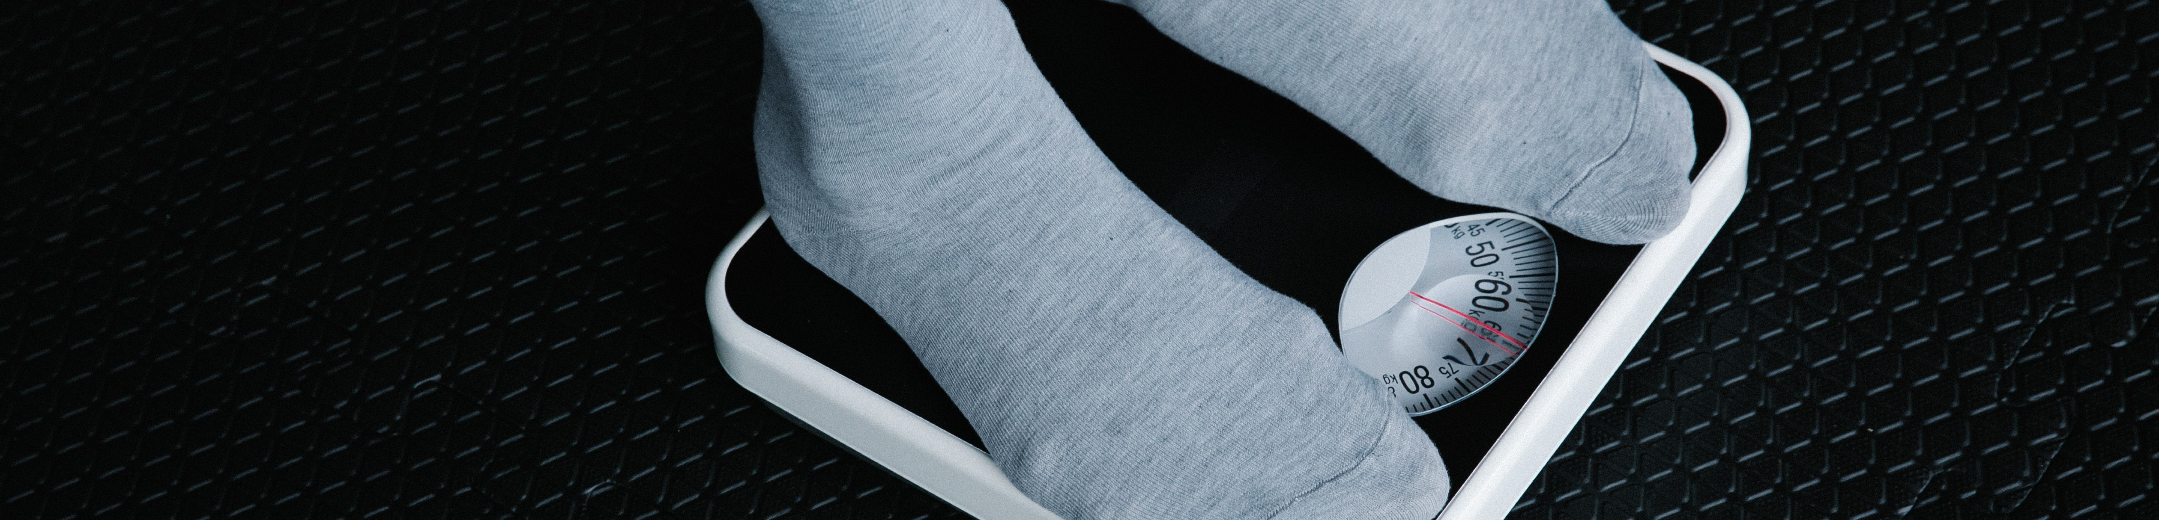
Introduction
There are studies that link physical activity to obesity but very few that also consider family history as a contributing factor in Obesity of an individual. Our aim is to find correlation between the Family history of the individuals and obesity in the data set.

Slide 4
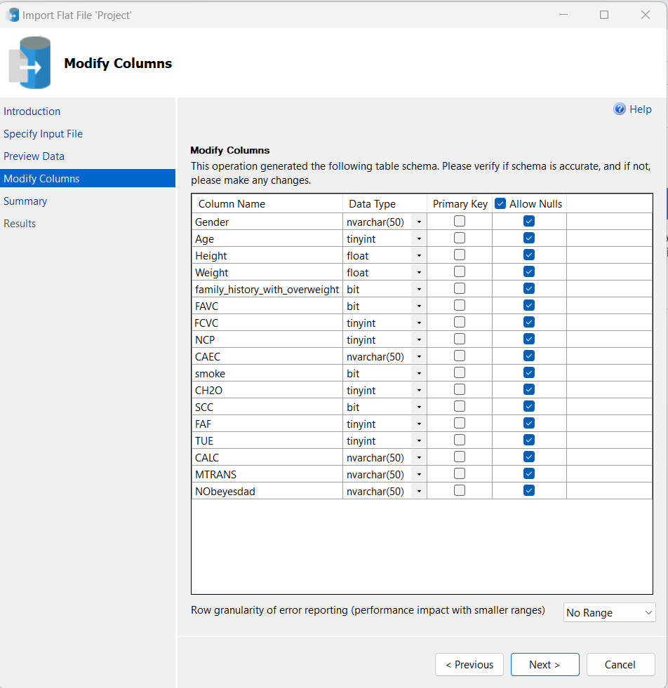
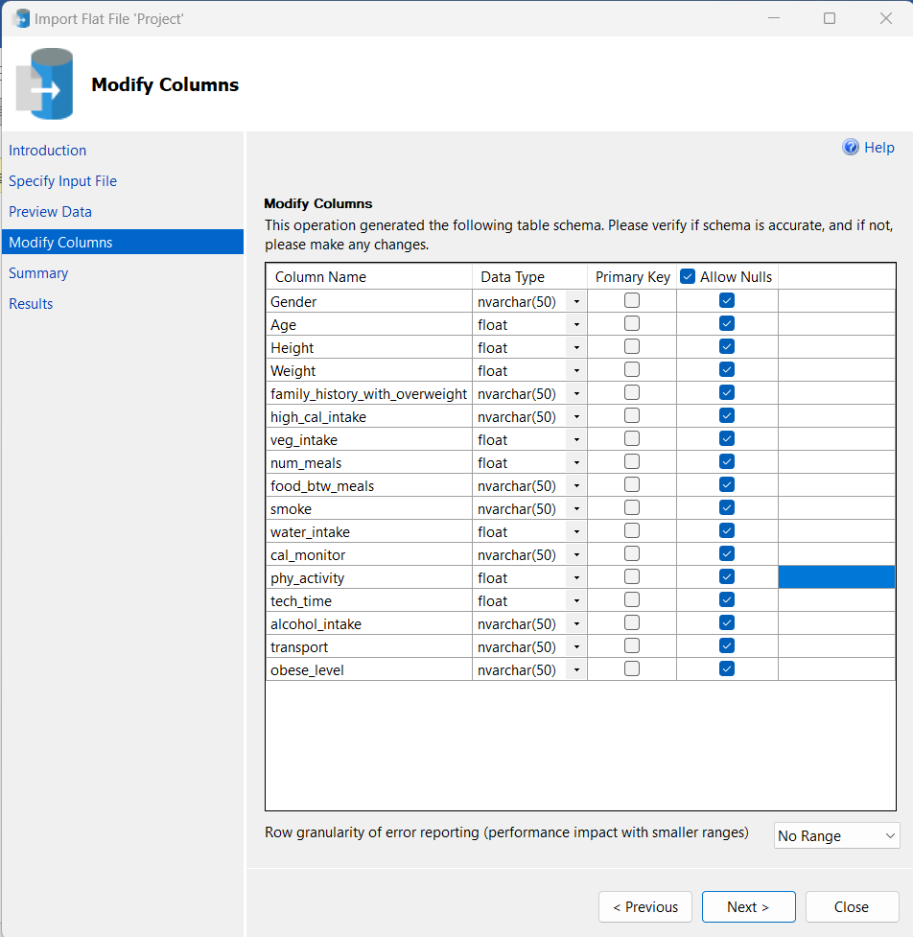
Data dictionary
The data contains 16 attributes and 2111 records.
77% of the data was generated synthetically using the Weka tool and the SMOTE filter, 23% of the data was collected directly from users through a web platform.
The records are labeled with the class variable ‘Obesity Level’, that allows classification of the data using the values.

Slide 5
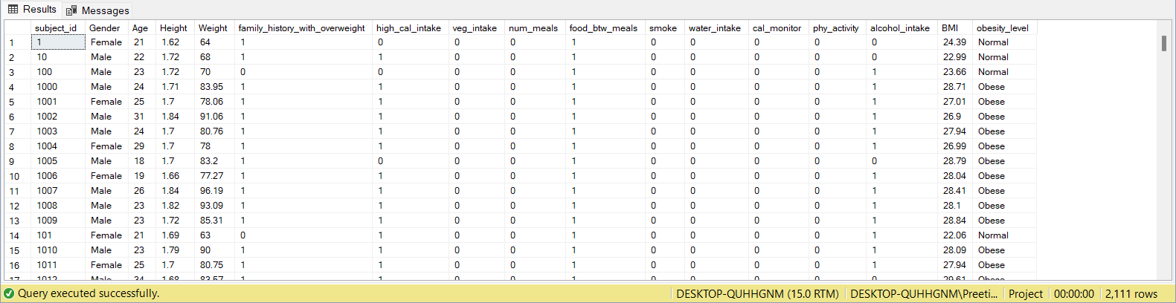
Pre-processing data
The steps include:
Renaming variables and changing data types.
Round-off the values and converting the numeric data to binary.
Calculating and adding Body Mass Index (BMI) column.
Joining the tables

Slide 6
Methodology
Correlation Matrix
Application of Association Rule Mining (ARM) algorithm
FP Growth algorithm
Performed three methods to build models using Weka tool:
Training set – Percentage split method
Testing set

Slide 7
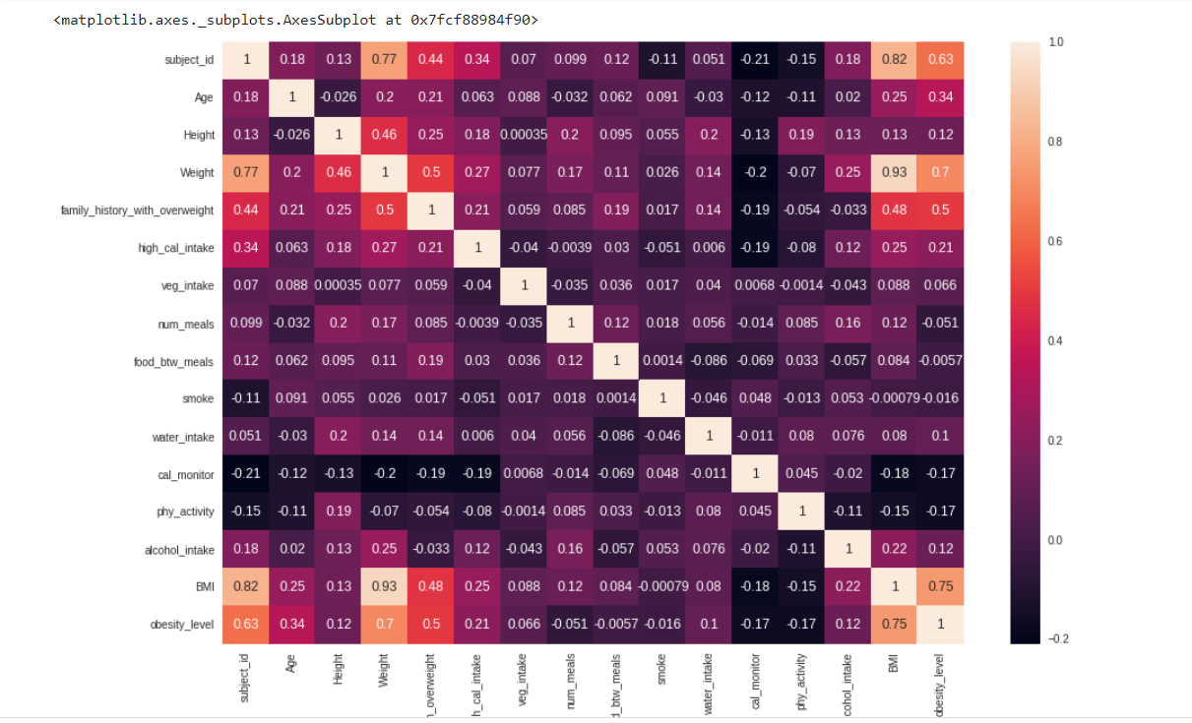
Correlation Matrix

Slide 8
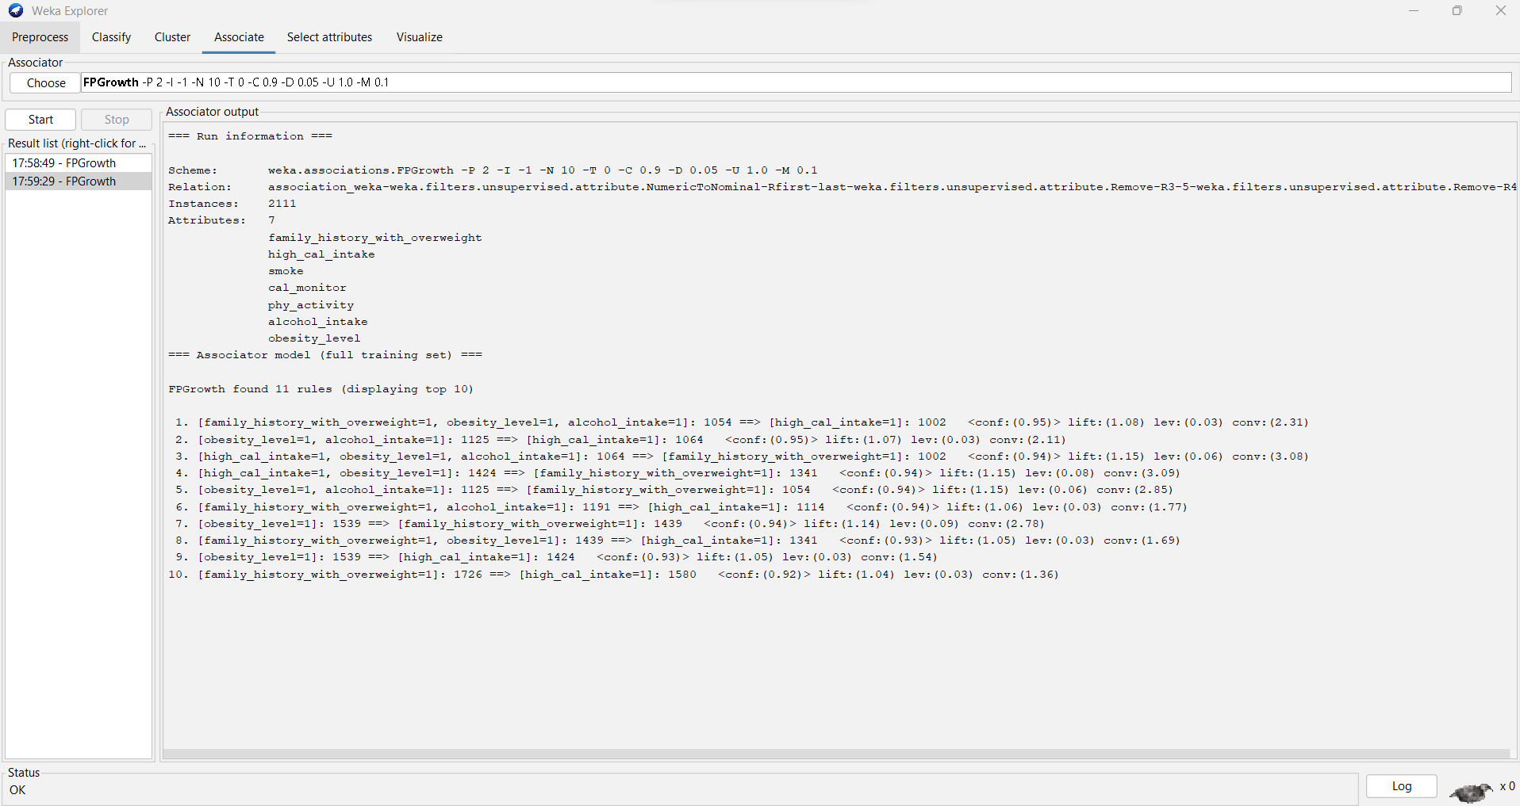
ARM: FP Growth Algorithm

Slide 9
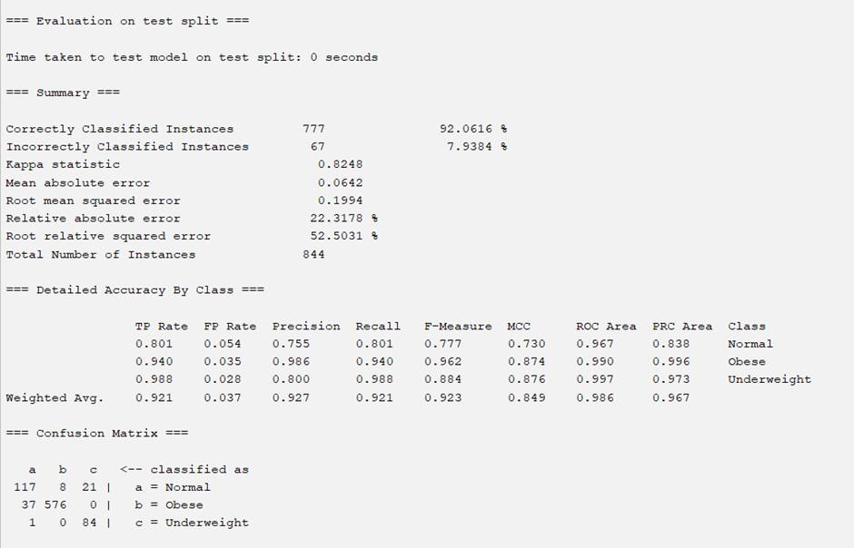
Naïve Bayes: Percentage Split

Slide 10
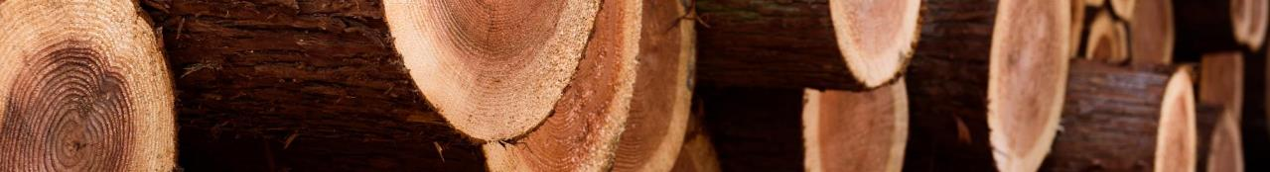
Percentage-Split
MODEL | PRECISION | RECALL | ROC AREA
Naïve Bayes | 0.949 | 0.947 | 0.997
Logistic | 0.947 | 0.944 | 0.982
SMO | 0.923 | 0.921 | 0.970
Random Forest | 0.991 | 0.991 | 1
KNN | 0.896 | 0.897 | 0.923
Random Tree | 0.976 | 0.978 | 0.988

Slide 11
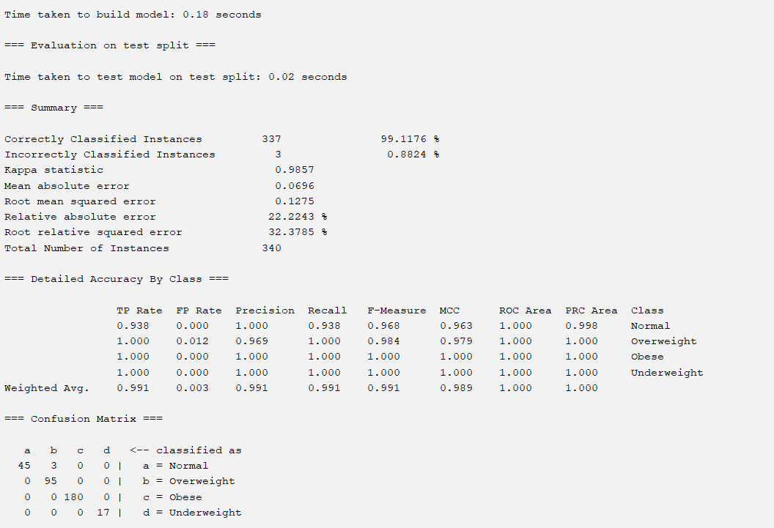
Naïve Bayes: Percentage Split

Slide 12
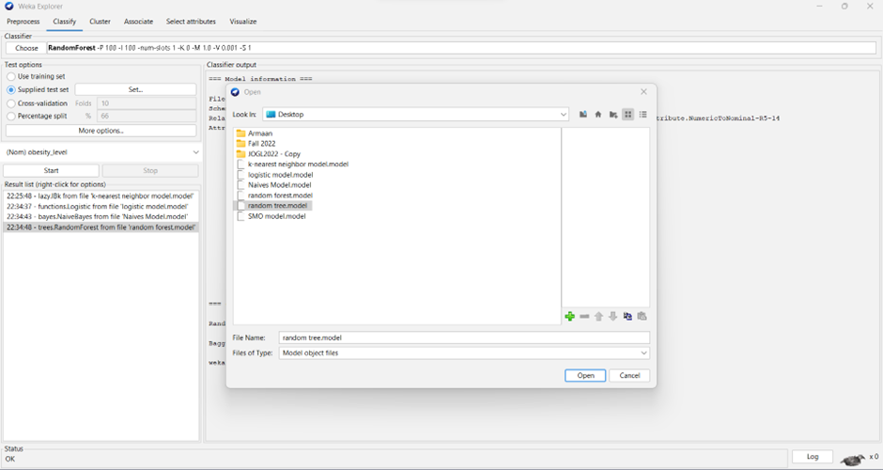
Evaluating model

Slide 13
Testing set
MODEL | PRECISION | RECALL | ROC AREA
Naïve Bayes | 0.64 | 0.65 | 0.825
Logistic | 0.578 | 0.553 | 0.703
SMO | 0.720 | 0.726 | 0.806
Random Forest | 0.778 | 0.768 | 0.923
KNN | 0.797 | 0.803 | 0.909
Random Tree | 0.713 | 0.715 | 0.762

Slide 14
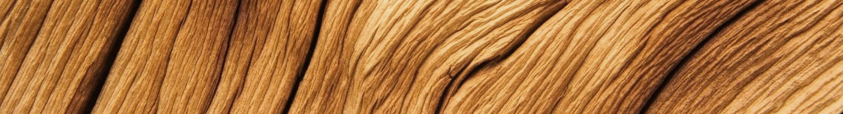
Summary
Exploratory data analysis
MODEL BUILDING
Performed using SQL queries.
Removing null values and inconsistent data
Updating data types
Converting categorical data to binary form
Calculating BMI
Associating rules for the binary attributes using FP Growth algorithm with different output.
Building supervised classification models like Naïve Bayes, kNN to get the accurate results for precision, recall, and AUC.

Slide 15
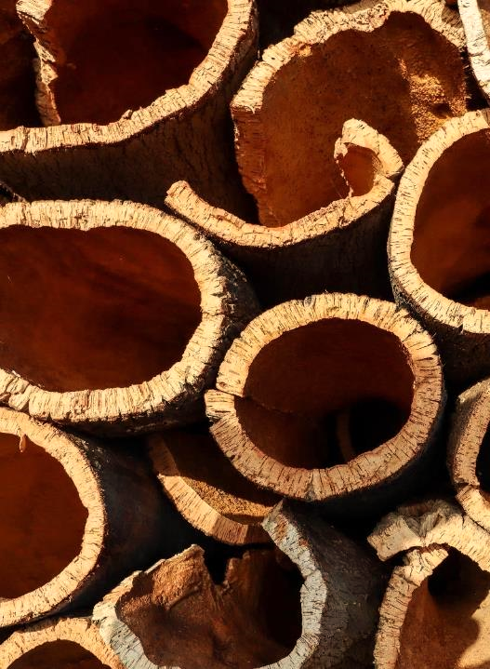
Conclusion
Correlation matrix: Individual has a risk factor for obesity from family history.
Association rules: The other lifestyle choices like alcohol consumption, high calorie food consumption can be another risk factor for obesity.
Logistic Regression, and Random Forest has a higher accuracy compared to other models.

Slide 16
References
World Obesity Atlas 2022. (n.d.). World Obesity Federation. https://www.worldobesity.org/resources/resource-library/world-obesity-atlas-2022
State of Obesity 2022: Better Policies for a Healthier America. (n.d.). Tfah. https://www.tfah.org/report-details/state-of-obesity-2022/#:~:text=Nationally%2C%2041.9%20percent%20of%20adults
‌Boston, 677 H. A., & Ma 02115 +1495‑1000. (2012, October 21). Obesity Causes. Obesity Prevention Source. https://www.hsph.harvard.edu/obesity-prevention-source/obesity-causes/#:~:text=Many%20factors%20influence%20body%20weight
‌National Heart, Lung, and Blood Institute. (2019). Assessing Your Weight and Health Risk. Nih.gov. https://www.nhlbi.nih.gov/health/educational/lose_wt/risk.htm
Mangla, A. G., Dhamija, N., Gupta, U., & Dhall, M. (2019). Familial Background as a Hidden Cause for Obesity among College Going Girls. Journal of Biosciences and Medicines, 07(04), 1–13. https://doi.org/10.4236/jbm.2019.74001
‌Traversy, G., & Chaput, J.-P. (2015). Alcohol Consumption and Obesity: An Update. Current Obesity Reports, 4(1), 122–130. https://doi.org/10.1007/s13679-014-0129-4
‌Corica, D., Aversa, T., Valenzise, M., Messina, M. F., Alibrandi, A., De Luca, F., & Wasniewska, M. (2018). Does Family History of Obesity, Cardiovascular, and Metabolic Diseases Influence Onset and Severity of Childhood Obesity? Frontiers in Endocrinology, 9. https://doi.org/10.3389/fendo.2018.00187
‌Bahreynian, M., Qorbani, M., Khaniabadi, B. M., Motlagh, M. E., Safari, O., Asayesh, H., & Kelishadi, R. (2017). Association between Obesity and Parental Weight Status in Children and Adolescents. Journal of Clinical Research in Pediatric Endocrinology, 9(2), 111–117. https://doi.org/10.4274/jcrpe.3790
CDC. (2011). Body Mass Index: Considerations for Practitioners What is BMI?
https://www.cdc.gov/obesity/downloads/bmiforpactitioners.pdf

Slide 17
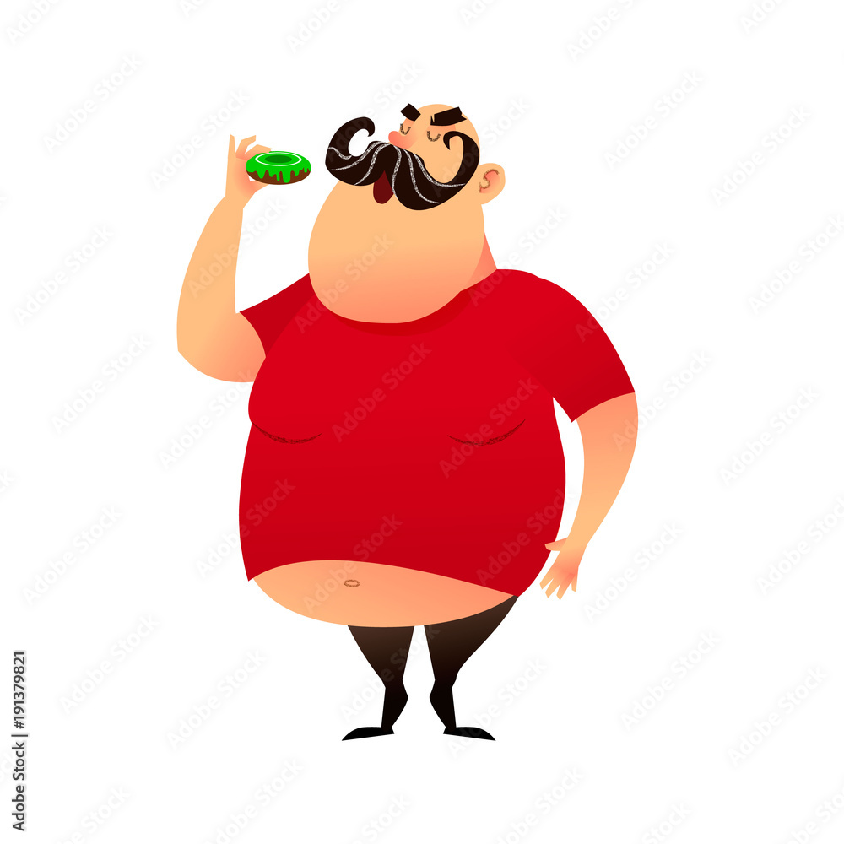
Thank you

